Slide 1

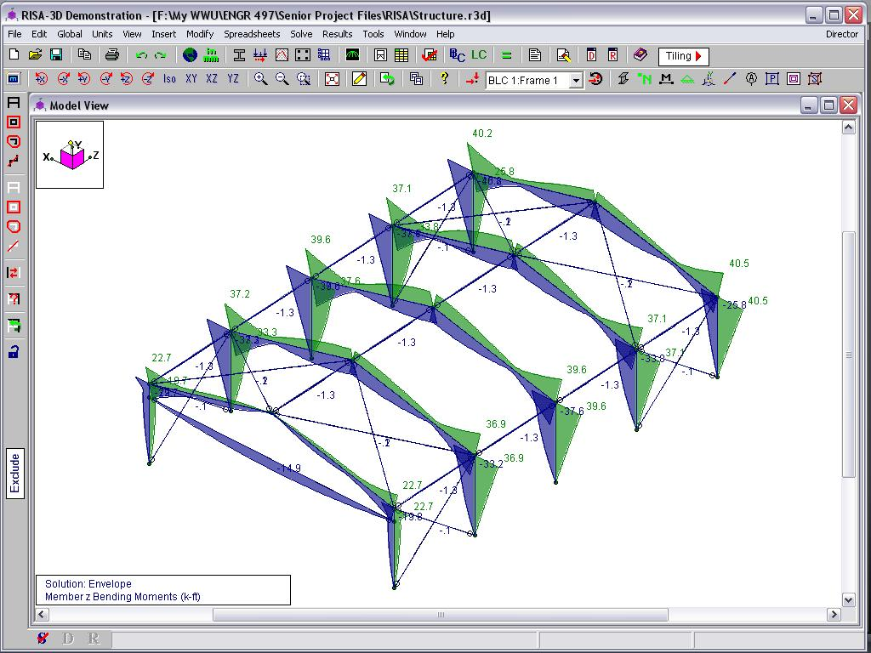
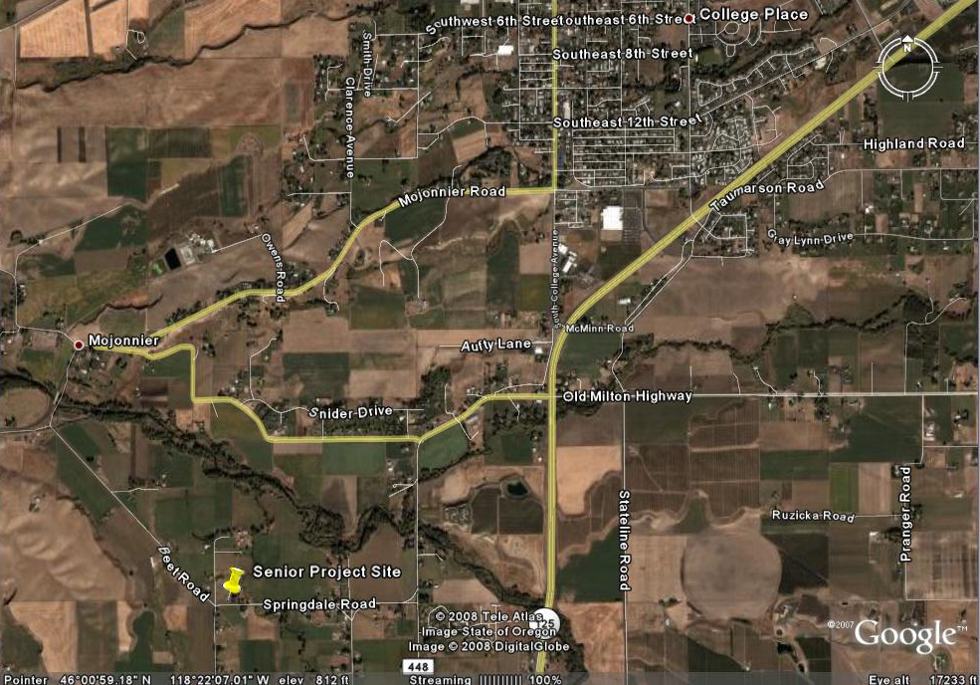
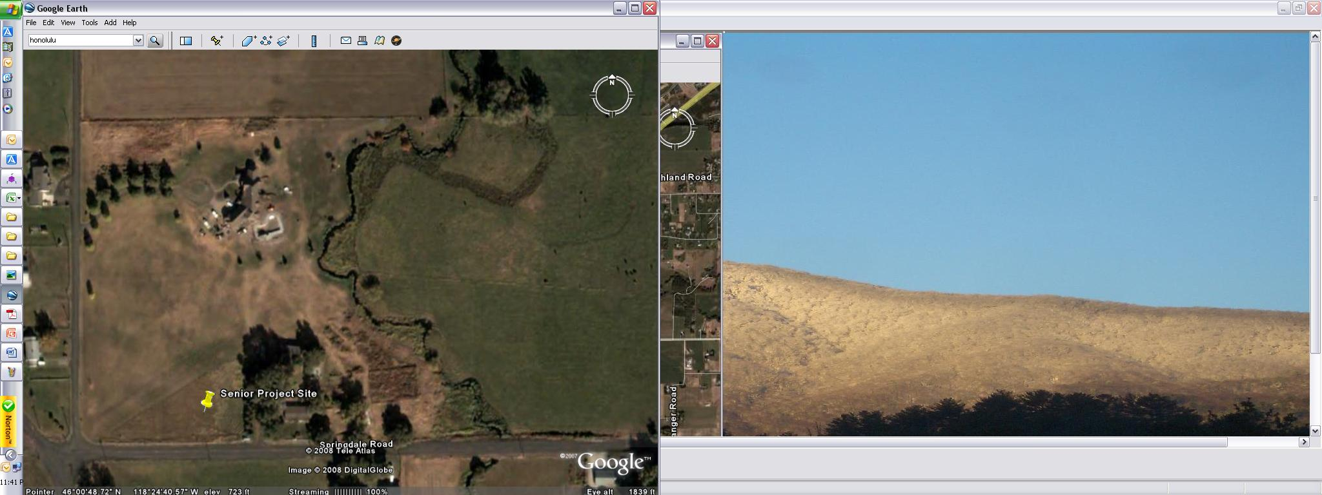
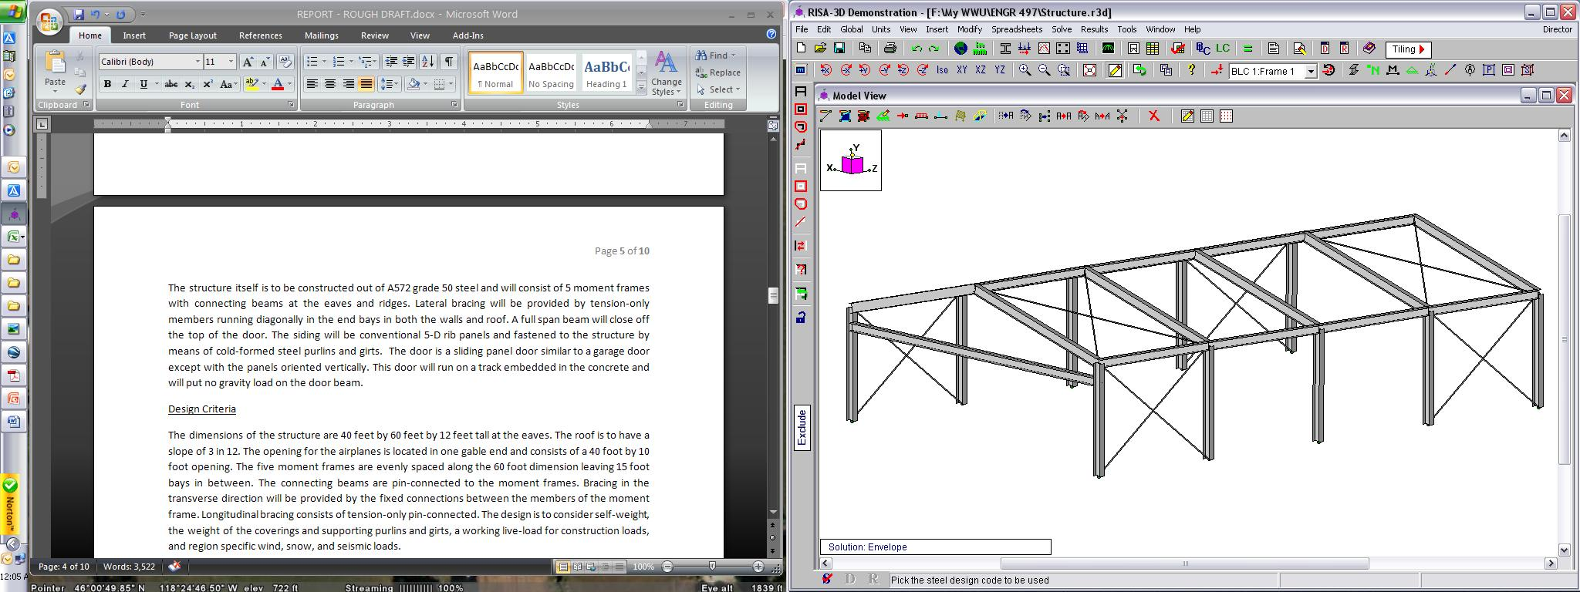
Airplane Hangar Design
The design of a steel-framed airplane hangar
Matthew Klein
Edward F. Cross School of Engineering, Walla Walla University, College Place, Washington
ABSTRACT
The purpose of this project is to design a steel-framed airplane hangar. The basic tasks required are to determine the applicable loads, analyze the frame and calculate member forces, and size the members to handle the applied loads. In addition, a cost comparison between different types of structures is provided.
DESIGN PROCEDURE
The design procedure consists of four stages: 1) determining the loads, 2) creating a model in a structural analysis program and analyzing member forces and deflections, 3) designing and optimizing structural members, and 4) compiling a cost estimate and comparison.
DETERMINE THE LOADS. The basic load categories that apply to this building are dead, live, wind, snow, and seismic loads. The Walla Walla Ordinance No. 346 was used to find the loading conditions adopted by the local jurisdiction. The basic load cases and load combinations were developed according to the ASCE 7-05 Minimum Design Loads for Buildings and Other Structures.
COMPUTER MODELING. The modeling program of choice was RISA, which stands for Rapid Interactive Structural Analysis. RISA allows users to input member properties, load cases, and boundary conditions using a graphical user interface (GUI). The load combinations were inputted in spreadsheet format. Upon running, the software calculates the member forces and deflections based on the stiffness method.
COMPONENT DESIGN. The actual design process considers three failure mechanisms. These are the combined axial and moment capacities, shear capacities, and deflection tolerances. The 13 ed. AISC Steel Construction Manual is used to efficiently evaluate these states. The method used to check the eligible members to determine the lightest and therefore cheapest section was to create a spreadsheet with the calculation of the available strength and compare them to the ultimate forces generated by RISA (see Figure 2).
RESULTS
The final choice for the design was a W12X40 for the moment frames, a 10X49 for the door beam, W10X33 for the connecting beams, and a ¾ inch tension rod. The maximum deflection in the roof was just over a half inch and just over a quarter of an inch in the walls. The door beam experienced a deflection of a half inch in the local-y direction and just over 2 inches in the local-x direction.
INTRODUCTION
The 13-acre property where the structure is to be built is located about five miles south of College Place, WA in Walla Walla County. The relative terrain is mostly flat with a few trees and a small river, the East Walla Walla River, passing through the property. However, some 40 foot bluffs unique to the Walla Walla Valley are within 1,500 feet of the proposed building site. A grass landing strip bisects the property diagonally (See Figure 1.)
Figure 3: Example of RISA’s Output
The cost for the engineered structure represented February 2008 steel prices, secondary frame, cladding, and estimated engineering costs. The cost was slightly lower than that obtained from a custom steel builder but much greater than the pre-engineered building suppliers and also higher than a comparable wood structure as shown in Figure 4.
Number | W Shape | Axial | Strong axis bending | Weak axis bending | Unity Check | Unity Limit | Summary
18 | 10X54 | 0.0164 | 0.2484 | 0.0224 | 0.2871 | 1 | OK
19 | 10X49 | 0.0180 | 0.2768 | 0.0248 | 0.3196 | 1 | OK
20 | 10X45 | 0.0198 | 0.3034 | 0.0346 | 0.3578 | 1 | OK
21 | 10X39 | 0.0232 | 0.3634 | 0.0408 | 0.4273 | 1 | OK
22 | 10X33 | 0.0278 | 0.4501 | 0.0499 | 0.5279 | 1 | OK
A
B
Figure 2: Example of Optimization Table (for initial design sizes), AISC Part 6
Figure 1: Senior Project Site (Google Earth)
COST. The last part of the design was to include a cost estimate and comparison to other equivalent designs . This included a cost of the designed structure based on the component sizes and commonly accepted construction techniques. The costs of similar structures were researched to provide the comparison.
The specified dimensions are 40 feet by 60 feet by 12 feet tall with a roof slope of 3 in 12. The airplane door is 40 foot by 10 foot. Five moment frames providing resistance to transverse direction loads are evenly spaced along the 60 foot dimension. Connecting beams and tension-only braces transfer longitudinal loadings to the foundation.
Figure 4: Cost Comparison
Moment Frame
Connecting Beam
REFERENCES
AISC Steel Construction Manual. 13th ed. 2006-.
ASCE 7-05 Minimum Design Loads for Buildings and other Structures. 2006-.
International Building Code. 2006-.
McCormac, Jack C. Structural Steel Design. 4th ed. 2008.
Summers, Mark. Technical Advisor. U.S. Army Corps of Engineers.
Walla Walla Ordinance No. 346. 2007-.
SUMMARY
In accordance with the objective of the project the following tasks have been accomplished: determine the loads the structure will be exposed to, analyze the structure using RISA, size the structural members, and estimate the cost. However, the project does not represent a complete structural design and the sliding door, an engineered foundation, and site plan are necessary to complete the total package.
Door Beam
Tension-only Brace
Figure 2: Proposed Design
In partial fulfillment of the requirements for ENGR 498, Senior Seminar

